Slide 1

Polynomial Regression
Aksadur Rahman

Slide 2
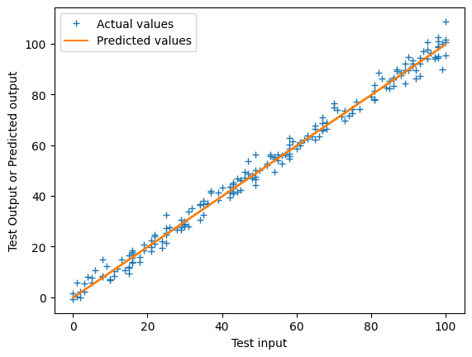
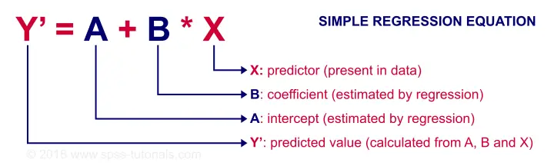
Linear Regression

Slide 3
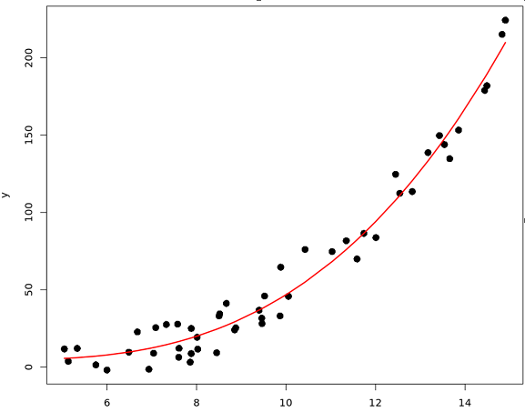
Polynomial Regression

Slide 4
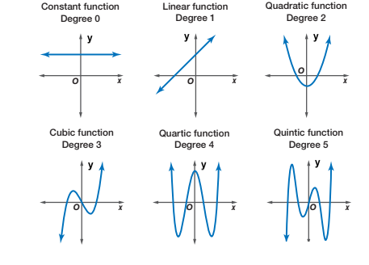
Types of Polynomial Regression

Slide 5
